Slide 1
EARTHQUAKE PREDICTION
GOWTHAM.R/VVCET

Slide 2
TOPICS
Empathize
Define
Ideate
Prototype
Test
Implement
Monitor and Iterate

Slide 3
Empathize
Understand the needs and concerns of the stakeholders, including governments, emergency services, researchers, and the general public.
Collect data and insights on the historical patterns of earthquakes, their impact, and the challenges associated with prediction.

Slide 4
Define
Clearly define the goals and objectives of earthquake prediction, such as reducing casualties, minimizing property damage, and providing early warnings.
Identify key constraints, such as available technology and resources.

Slide 5
Ideate
Brainstorm potential solutions and approaches for earthquake prediction, considering both existing methods and innovative technologies.
Encourage multidisciplinary collaboration among geologists, seismologists, data scientists, and engineers.

Slide 6
Prototype
Develop a prototype or a proof-of-concept for the earthquake prediction system, integrating various data sources, technologies, and algorithms.
Conduct simulations and experiments to test the feasibility of the proposed solution.

Slide 7
Test
Test the prototype in a controlled environment to evaluate its accuracy and reliability.
Gather feedback from experts and stakeholders to refine the system further.

Slide 8
Implement
Develop a production-ready version of the earthquake prediction system.
Establish infrastructure and protocols for data collection, analysis, and dissemination of earthquake predictions.

Slide 9
Monitor and Iterate
Continuously monitor the system's performance and improve it over time by incorporating new data and insights.
Collaborate with the scientific community to stay updated on the latest advancements in earthquake prediction.

Slide 10
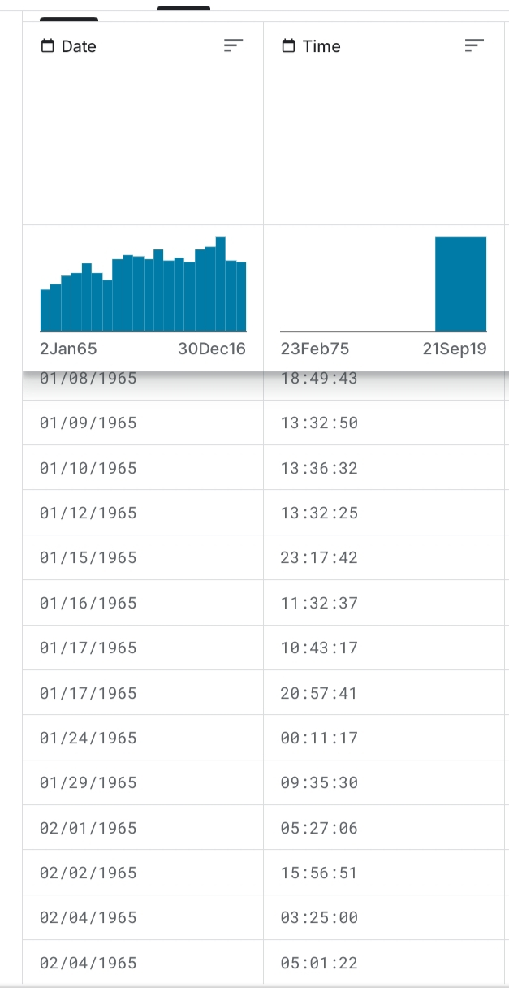

Slide 11
Dataset Used
Data Preprocessing Steps
Feature Extraction Techniques

Slide 12
1. Dataset Used
Seismic Data
The primary dataset for earthquake prediction consists of seismic measurements.
This data is collected from seismometers and can include parameters such as ground motion, frequency, and amplitude.
These measurements can be obtained from various sources, including seismic networks and research institutions.

Slide 13
Geological Data
Geological information about fault lines, tectonic plate movements, and geological structures in the region of interest can be crucial.
This data can help identify areas with a higher earthquake risk.

Slide 14
Historical Earthquake Data
Historical records of earthquake occurrences, including their magnitudes, depths, and locations, are essential for training and validating prediction models.

Slide 15
Environmental Data
Environmental factors such as weather conditions, temperature, and atmospheric pressure can sometimes be correlated with seismic activity.
Including these data can help improve prediction accuracy.

Slide 16
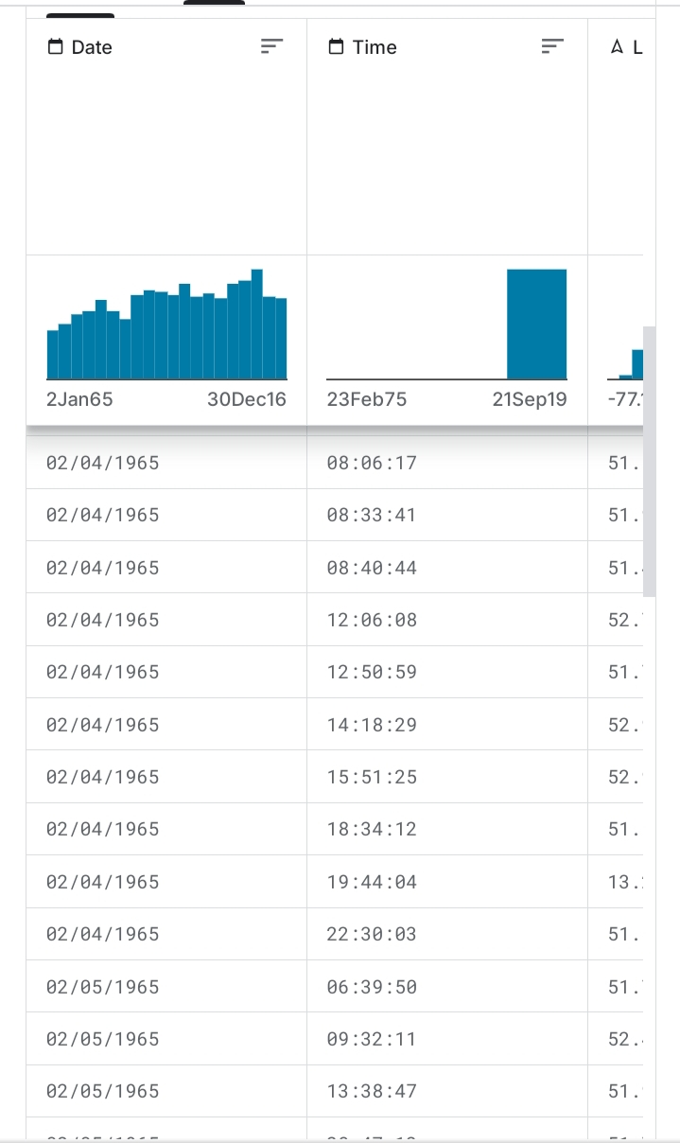

Slide 17
2.Data Preprocessing Steps
Data Cleaning
Remove or fill missing values, correct anomalies, and ensure data quality.
Data Integration
Combine data from various sources into a unified dataset, mapping them to a common spatiotemporal framework.

Slide 18
Data Normalization/Standardization
Normalize or standardize features to ensure they have similar scales. This can be particularly important when working with various types of data.
Feature Engineering
Create new features that capture meaningful information from the raw data. For instance, you might calculate the mean, standard deviation, or other statistical properties of seismic measurements over a specific time window.

Slide 19
Temporal Aggregation
Aggregate data over time intervals to reduce the temporal granularity, which can help capture long-term trends.
Feature Scaling
Scaling features to the same range can be helpful for certain machine learning algorithms.

Slide 20
Data Splitting
Divide the dataset into training, validation, and test sets to evaluate the model's performance.

Slide 21
3.Feature Extraction Techniques:
Statistical Features
Compute statistical measures like mean, median, standard deviation, skewness, and kurtosis for seismic measurements over a specific time window.
Frequency Domain Features
Use techniques like Fourier or wavelet transforms to extract frequency domain information from seismic signals.

Slide 22
Spectral Analysis
Compute spectral features, such as dominant frequencies or power spectral density, to understand the frequency components of seismic signals.
Spatial Features
Calculate spatial features based on the locations of seismometers and geological data.
For instance, distance to fault lines or tectonic plate boundaries.

Slide 23
Time Series Analysis
Apply time series analysis techniques to detect temporal patterns, trends, and seasonality in seismic data.
Machine Learning-Based Feature Selection
Utilize machine learning models to identify the most relevant features through feature selection methods like recursive feature elimination or feature importance scores.

Slide 24
Deep Learning-Based Feature Extraction
Use deep learning models, such as convolutional neural networks (CNNs) or recurrent neural networks (RNNs), to automatically learn and extract features from raw seismic data.
The choice of dataset, data preprocessing steps, and feature extraction techniques will depend on the specific goals of your earthquake prediction model and the available data sources

